Slide 1
고급웹프로그래밍
VueJs
Frontend
VueJs frondend App

Slide 2
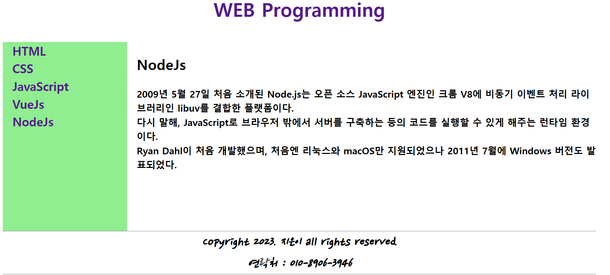
VueJs Frontend
Vue_1
전체 화면

Slide 3
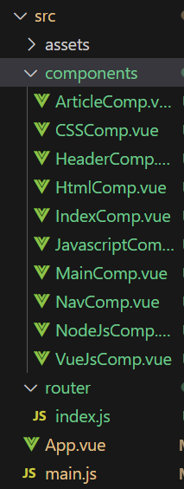
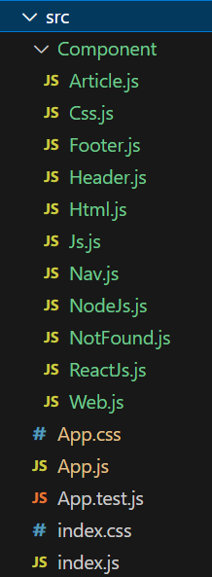
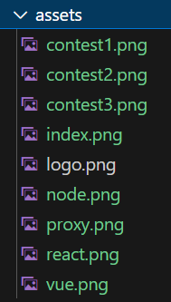
VueJs Frontend
Vue_1
VueJs
ReactJs
VueJs 디렉토리 구조
Main Component
App.vue
자식 Component
HeaderComp.vue
NavComp.vue
MainComp.vue
ArtiComp.vue
IndexComp.vue
HtmlComp.vue
CSSComp.vue
JavascriptComp.vue
VueJsComp.vue
NodeJsComp.vue
router/index.js
Router 설정

Slide 4
VueJs Frontend
vue_1
main.js
router 추가
import { createApp } from "vue";
import App from "./App.vue";
import router from "./router";
const app = createApp(App);
app.use(router); // 라우팅
app.mount("#app"); // 마운팅
Vue Router 설치
npm i --legacy-peer-deps
npm install vue-router@next --save

Slide 5
VueJs Frontend
vue_1
<template>
<div id = "index">
<HeaderComp />
<div id="container">
<NavComp/>
<MainComp/>
</div>
<FooterComp/>
</div>
</template>
<script>
import HeaderComp from './components/HeaderComp.vue'
import NavComp from './components/NavComp.vue'
import MainComp from './components/MainComp.vue'
import FooterComp from './components/FooterComp.vue'
export default {
name: 'App',
components: {
HeaderComp,
NavComp,
MainComp,
FooterComp,
}
}
</script>
<style src="./App.css"></style>
App.vue
자식 Component
HeaderComp
NavComp
MainComp
FooterComp
JavaScript
자식 컴포넌트 등록
외부 CSS 등옥

Slide 6
VueJs Frontend
vue_1
HeaderComp.vue
자식 Component
HeaderComp
NavComp
MainComp
FooterComp
<template>
<div id = "header">
<router-link class = "link" to="/"> WEB Programming </router-link>
</div>
</template>
NavComp.vue
<template>
<div id="nav">
<router-link class="link" to="/HTML"> HTML </router-link>
<router-link class="link" to="/CSS"> CSS </router-link>
<router-link class="link" to="/JavaScript"> JavaScript </router-link>
<router-link class="link" to="/VueJs"> VueJs </router-link>
<router-link class="link" to="/NodeJs"> NodeJs </router-link>
</div>
</template>
MainComp.vue
<template>
<div id = "main">
<router-view />
</div>
</template>
<template>
<div id = "footer">
<i>
Copyright 2023. 지은이 all rights reserved.
<br />
연락처 : 010-8906-3946
</i>
</div>
</template>
FootervComp.vue

Slide 7
VueJs Frontend
vue_1
Router 설정 파일
src/router/index.js
{
path: "/Javascript",
component: JavascriptComp,
},
{
path: "/VueJs",
component: VueJsComp,
},
{
path: "/NodeJs",
component: NodeJsComp,
},
];
const router = createRouter({ // 라우트 생성
history: createWebHistory(),
routes,
});
export default router;
import { createWebHistory, createRouter } from "vue-router";
import IndexComp from "@/components/IndexComp.vue";
import HtmlComp from "@/components/HtmlComp.vue";
import CSSComp from "@/components/IndexComp.vue";
import JavascriptComp from "@/components/JavascriptComp.vue";
import VueJsComp from "@/components/VueJsComp.vue";
import NodeJsComp from "@/components/NodeJsComp.vue";
const routes = [
{
path: "/", // index Component
component: IndexComp,
},
{
path: "/Html",
component: HtmlComp,
},
{
path: "/CSS",
component: CSSComp,
},

Slide 8
VueJs Frontend
vue_1
App.css
CSS 외부파일
@import url("https://fonts.googleapis.com/css2?family=Song+Myung&display=swap");
@import url("https://fonts.googleapis.com/css2?family=Nanum+Gothic:wght@700&display=swap");
@import url("https://fonts.googleapis.com/css2?family=Nanum+Pen+Script&display=swap");
#index{
margin-left:50px ;
margin-right:50px ;
line-height: 1.5;
font-weight: bolder;
}
#header {
font-size: 40px;
height: 100px;
text-align: center;
}
#container {
display: flex;
}
#nav{
flex: 1;
padding-left: 20px;
height: 400px;
background-color: lightgreen;
font-size:25px
}
#main{
flex: 4;
padding-left: 20px;
font-size: 20px;
}
#main:hover {
background-color: lightpink;
}
#footer {
font-family: "Nanum Pen Script";
text-align: center;
border-top: 1px solid gray;
border-bottom: 1px solid gray;
font-size: 30px;
}
a {
display: block;
text-decoration: none;
}
a:hover {
background-color: orange;
color: white;
}

Slide 9
VueJs Frontend
vue_1
src/components/IndexComp.vue
<template>
<main>
<h2>Welcome</h2>
웹 프로그래밍은 웹사이트 혹은 웹 페이지를 만드는 과정을 말합니다.
<br />웹 사이트에 접속했을 때 보이는 화면을 구성하는 것들을 만들어 내는
작업.<br />
이 작업은 다양한 언어를 사용해 진행합니다. <br />웹 프로그래밍을 할 때는
HTML, CSS, JavaScript 같은 웹 브라우저 단에서 동작하는 코드<br />
Python, Ruby, PHP, Java 등 서버 컴퓨터쪽에서 동작하는 코드를 작성합니다.
</main>
</template>

Slide 10
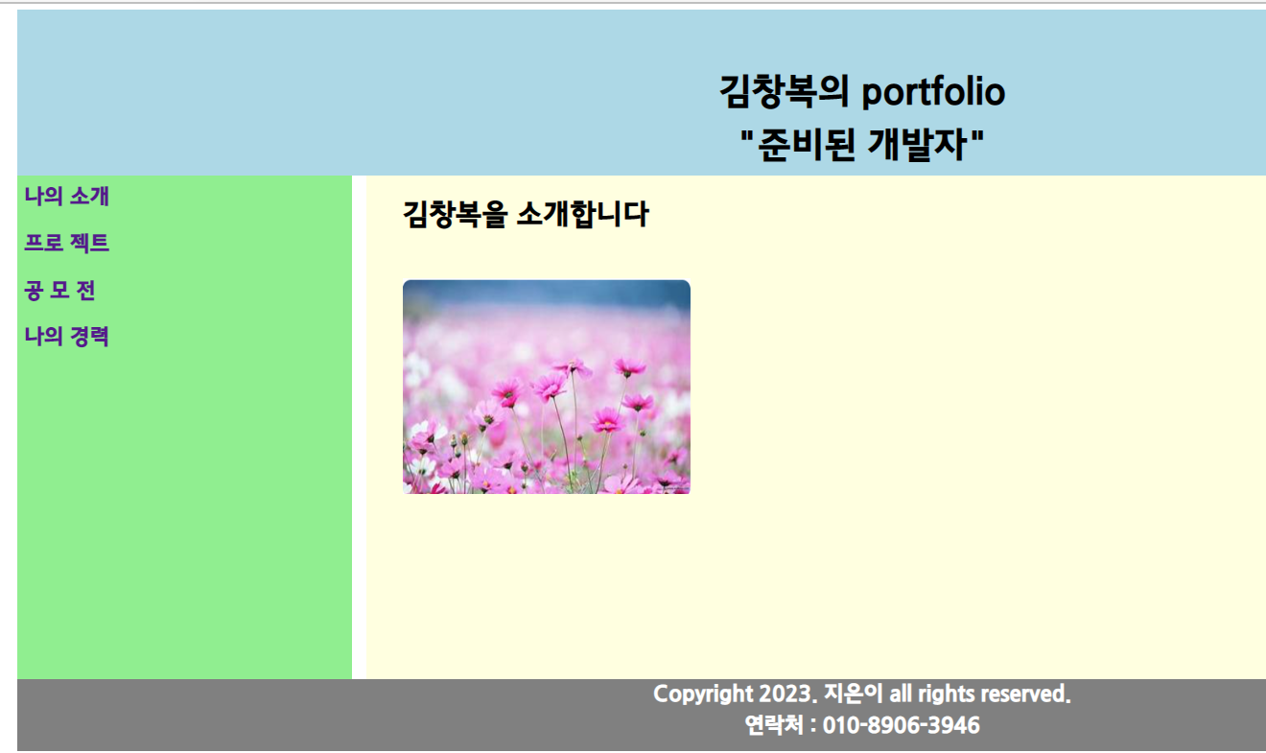
VueJs Frontend
vue_2
전체 화면

Slide 11
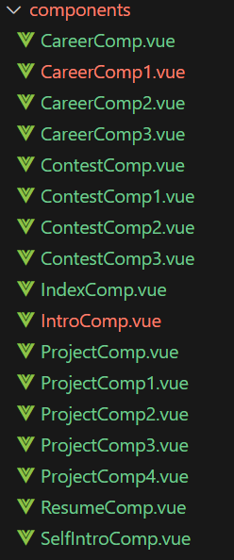
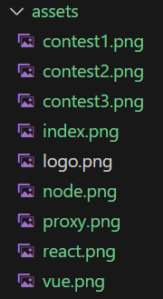
VueJs Frontend
vue_2
전체 Component 구성
Main menu Component | Sub menu Component | Contens
Introduction | ResumeComp | 이력서
 | SelfIntroComp | 자기소개서
Project | ProjectComp1 | ReactJs 프로젝트
 | ProjectComp2 | VueJs 프로젝트
 | ProjectComp3 | NodejS 프로젝트
 | ProjectComp4 | Proxy 구성 프로젝트
Contest | ContestComp1 | 00 공모전 공모
 | ContestComp2 | 00 공모전 공모
 | ContestComp3 | 00 공모전 공모
Career | CareerComp1 | 아르바이트 및 인턴
 | CareerComp2 | 사회 봉사 및 연수
 | CareerComp3 | 자격증 및 그외 스펙

Slide 12
VueJs Frontend
vue_2
App.vue
Main Component
<footer>
Copyright 2023. 지은이 all rights reserved.
<br />
연락처 : 010-8906-3946
</footer>
</div>
</template>
<style src="./App.css"> </style>
<template>
<div id ="index" >
<header>
김창복의 portfolio
<br />
"준비된 개발자"
</header>
<div id="container">
<div id ="nav">
<router-link class="link1" to="/introduction"> 나의 소개 </router-link>
<router-link class="link1" to="/project"> 프로 젝트 </router-link>
<router-link class="link1" to="/contest"> 공 모 전 </router-link>
<router-link class="link1" to="/career"> 나의 경력 </router-link>
</div>
<div id = "main">
<router-view />
</div>
</div>

Slide 13
VueJs Frontend
vue_2
App.css
SubMenu
Com-onent
.link2 {
text-align : center ;
padding-top : 5px ;
padding-bottom : 10px;
margin :10px ;
color : white ;
background-color: blue;
text-decoration : none ;
font-size : 1.8rem ;
}
.link2:hover {
background : orange ;
}
.link2:active {
background : white;
color : blue;
}
footer {
text-align: center;
background-color: gray;
color: white;
font-size: 30px;
height: 100px;
}
@import url(//fonts.googleapis.com/earlyaccess/jejugothic.css);
#index{
margin-left:50px ;
margin-right:50px ;
font-family : 'Jeju Gothic', sans-serif;
line-height: 1.5;
font-weight: bolder;
}
header {
font-size: 50px;
height: 150px;
padding-top: 80px;
background: lightblue;
text-align: center;
}
#container {
display: flex;
}
#nav{
flex: 1;
height: 700px;
background-color: lightgreen;
font-size:30px ;
}
#main{
flex: 4;
background-color: lightyellow;
font-size: 20px;
margin-left: 20px;
}
.link1{
display: block;
text-decoration: none;
padding: 10px;
}
.link1:hover {
background-color: orange;
color: white;
}
App.vue

Slide 14
VueJs Frontend
vue_2
IndexComp.vue
<template>
<div id="index">
<h1>김창복을 소개합니다</h1>
<br />
<img src="../assets/index.png" alt="나의 사진!!!" />
</div>
</template>
<style scoped>
img{
width: 400px;
height: 300px;
}
</style>

Slide 15

VueJs Frontend
vue_2
IntroComp.vue
중복 Router
나의 소개 Router
이력서 Router
자기소개서 Router
이력서 및 자기소개서 Component 는 코드 직접 확인
<template>
<div>
<router-link class="link2" to="/introduction/resume"> 이력서 </router-link>
<router-link class="link2" to="/introduction/selfintro"> 자기 소개서 </router-link>
<br /> <br />
<router-view />
</div>
</template>
IntroComp.vue

Slide 16
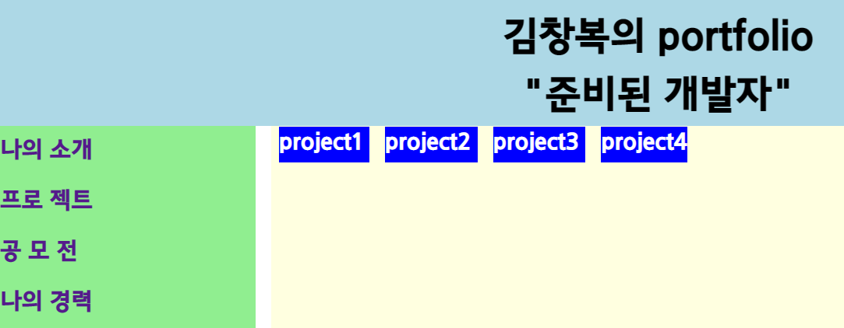
VueJs Frontend
vue_2
ProjectComp.vue
중복 라우터
<template>
<div>
<router-link class="link2" to="/project/project1"> project1 </router-link>
<router-link class="link2" to="/project/project2"> project2 </router-link>
<router-link class="link2" to="/project/project3"> project3 </router-link>
<router-link class="link2" to="/project/project4"> project4 </router-link>
<router-view />
</div>
</template>
<style>
.project{
margin-left: 100px;
}
fieldset {
width: 1000px;
margin-left: 50px;
font-size: 1.5em;
}
</style>
자식 Component style

Slide 17
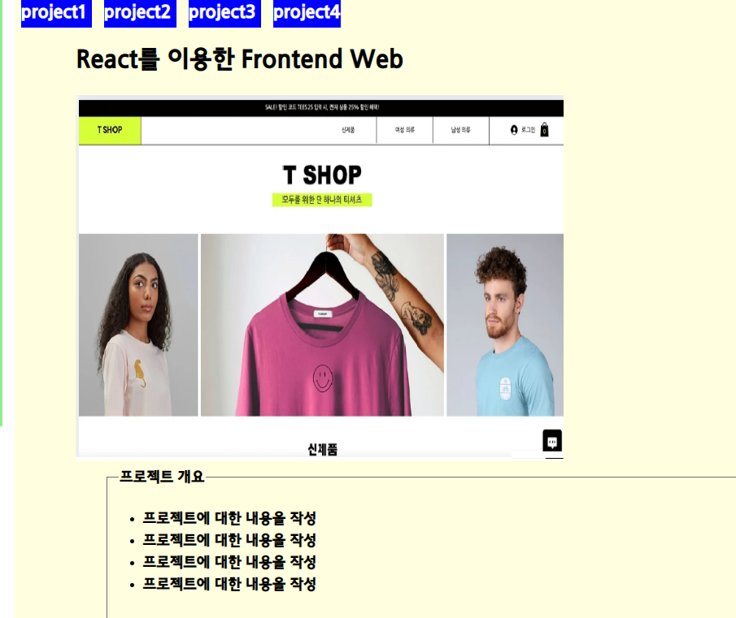
VueJs Frontend
vue_2
ProjectComp1.vue
<template>
<div class ="project">
<h1>React를 이용한 Frontend Web</h1>
<img src="../assets/react.png" alt="react" />
<fieldset>
<legend>프로젝트 개요</legend>
<ul>
<li>프로젝트에 대한 내용을 작성</li>
<li>프로젝트에 대한 내용을 작성</li>
<li>프로젝트에 대한 내용을 작성</li>
<li>프로젝트에 대한 내용을 작성</li>
</ul>
</fieldset>
</div>
</template>
<style scoped>
img{
width: 800px;
height :600px
}
</style>
현재 Component style
그림 size가 다름

Slide 18
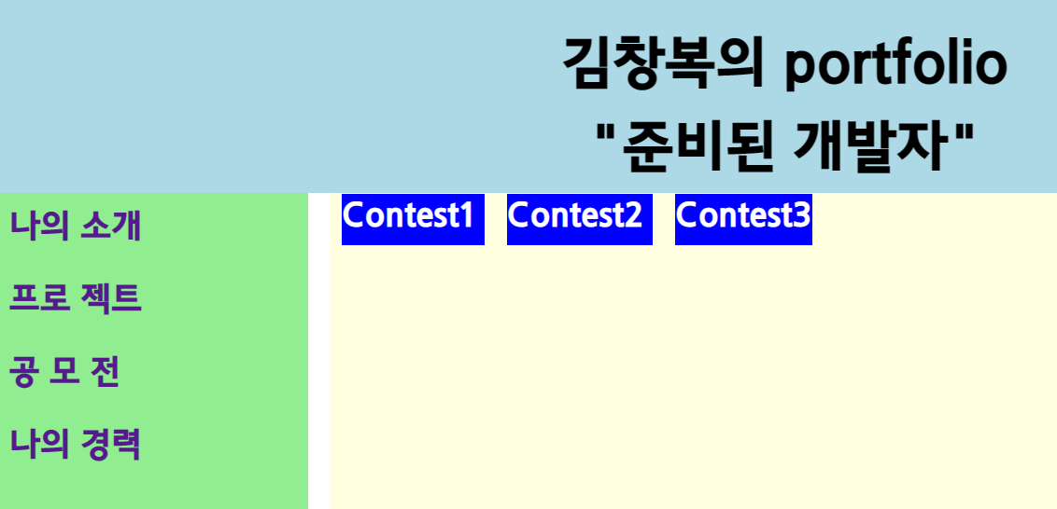
VueJs Frontend
vue_2
ContestComp.vue
중복 라우터
<template>
<div>
<router-link class="link2" to="/contest/contest1"> Contest1 </router-link>
<router-link class="link2" to="/contest/contest2"> Contest2 </router-link>
<router-link class="link2" to="/contest/contest3"> Contest3 </router-link>
<router-view />
</div>
</template>
<style>
.contest{
margin-left: 100px;
}
fieldset {
width: 1000px;
margin-left: 50px;
font-size: 1.5em;
}
</style>
자식 Component style

Slide 19

VueJs Frontend
vue_2
ContestComp1.vue
<template>
<div class = "contest">
<h1>공모전입니다.</h1>
<img src="../assets/contest1.png" alt="react" />
<fieldset>
<legend>공모전 개요</legend>
<ul>
<li>공모전에 대한 내용을 작성</li>
<li>공모전에 대한 내용을 작성</li>
<li>공모전에 대한 내용을 작성</li>
<li>공모전에 대한 내용을 작성</li>
</ul>
</fieldset>
</div>
</template>
<style scoped>
img{
width: 400px;
height :600px
}
</style>

Slide 20
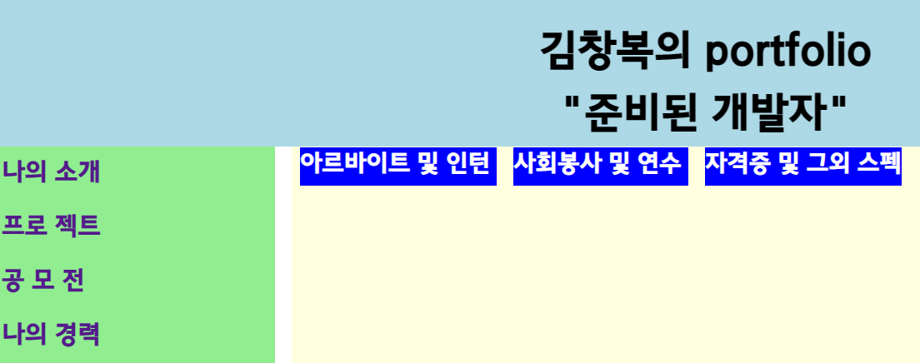
VueJs Frontend
vue_2
CareerComp.vue
중복 라우터
<template>
<div>
<router-link class="link2" to="/career/career1"> 아르바이트 및 인턴 </router-link>
<router-link class="link2" to="/career/career2"> 사회봉사 및 연수 </router-link>
<router-link class="link2" to="/career/career3"> 자격증 및 그외 스펙 </router-link>
<router-view />
</div>
</template>
<style>
.career{
margin-left: 100px;
}
fieldset {
width: 1000px;
margin-left: 50px;
font-size: 1.2em;
}
</style>
자식 Component style

Slide 21
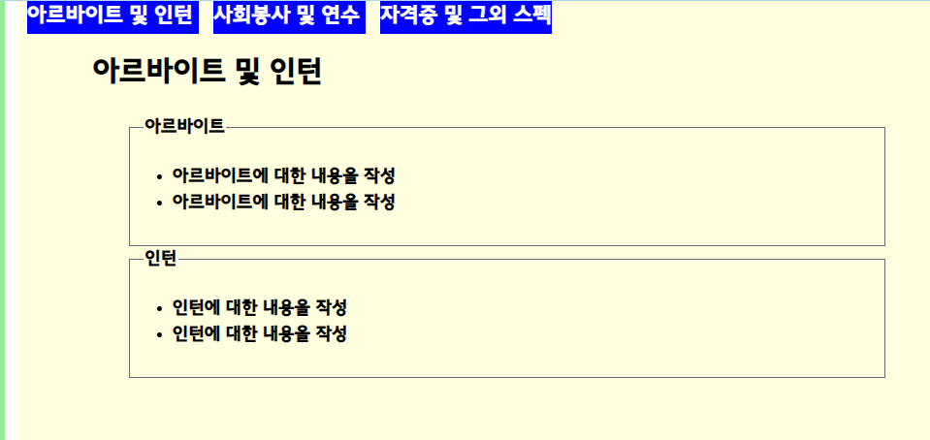
VueJs Frontend
vue_2
CareerComp1.vue
<template>
<div class="career">
<h1>아르바이트 및 인턴</h1>
<fieldset>
<legend>아르바이트</legend>
<ul>
<li>아르바이트에 대한 내용을 작성</li>
<li>아르바이트에 대한 내용을 작성</li>
</ul>
</fieldset>
<fieldset>
<legend>인턴</legend>
<ul>
<li>인턴에 대한 내용을 작성</li>
<li>인턴에 대한 내용을 작성</li>
</ul>
</fieldset>
</div>
</template>
<style scoped>
</style>

Slide 22
VueJs Frontend
vue_2
중복 라우팅
router/index.js
중복 라우팅
const routes = [
{
path: "/",
component: IndexComp,
},
{
path: "/introduction",
component: IntroComp,
children: [
{
path: "resume",
component: ResumeComp,
},
{
path: "selfintro",
component: SelfIntroComp,
},
],
},
import { createWebHistory, createRouter } from "vue-router";
import IndexComp from "../components/IndexComp";
import IntroComp from "../components/IntroComp";
import ResumeComp from "../components/ResumeComp";
import SelfIntroComp from "../components/SelfIntroComp";
import ProjectComp from "../components/ProjectComp";
import ProjectComp1 from "../components/ProjectComp1";
import ProjectComp2 from "../components/ProjectComp2";
import ProjectComp3 from "../components/ProjectComp3";
import ProjectComp4 from "../components/ProjectComp4";
import ContestComp from "../components/ContestComp";
import ContestComp1 from "../components/ContestComp1";
import ContestComp2 from "../components/ContestComp2";
import ContestComp3 from "../components/ContestComp3“
;
import CareerComp from "../components/CareerComp";
import CareerComp1 from "../components/CareerComp1";
import CareerComp2 from "../components/CareerComp2";
import CareerComp3 from "../components/CareerComp3";
중복 라우팅
Component
Children
Component
Component
Children
Component

Slide 23
VueJs Frontend
vue_2
중복 라우팅
{
path: "/project",
component: ProjectComp,
children: [
{
path: "project1",
component: ProjectComp1,
},
{
path: "project2",
component: ProjectComp2,
},
{
path: "project3",
component: ProjectComp3,
},
{
path: "project4",
component: ProjectComp4,
},
],
},

Slide 24
VueJs Frontend
vue_2
path: "/career",
component: CareerComp,
children: [
{
path: "career1",
component: CareerComp1,
},
{
path: "career2",
component: CareerComp2,
},
{
path: "career3",
component: CareerComp3,
},
],
},
];
const router = createRouter({
// 라우트 생성
history: createWebHistory(),
routes,
});
export default router;
중복 라우팅
{
path: "/contest",
component: ContestComp,
children: [
{
path: "contest1",
component: ContestComp1,
},
{
path: "contest2",
component: ContestComp2,
},
{
path: "contest3",
component: ContestComp3,
},
],
},
{

Slide 25
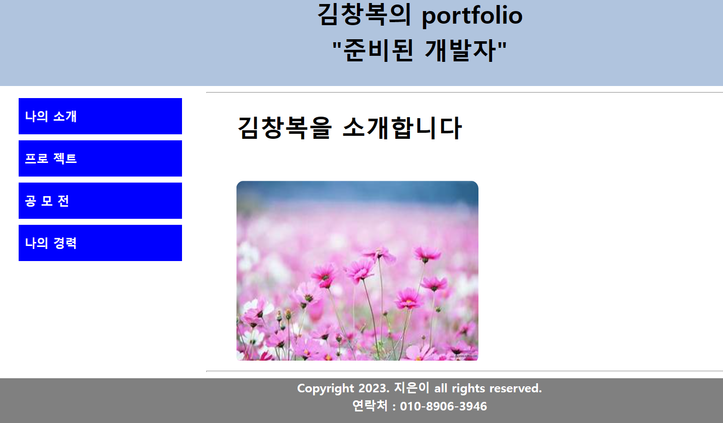
VueJs Frontend
vue_3
전체 화면
Mein Menu 만 변경했어요.

Slide 26
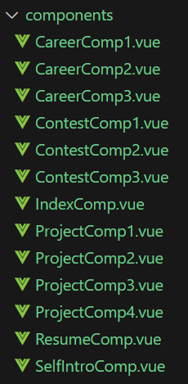
VueJs Frontend
vue_3
전체 Component 구성
메인 메뉴는 Routing 안함
메인 컴포넌트는 메뉴이름 만 존재
Main menu | menu Component | Contens
나의 소개 | ResumeComp | 이력서
 | SelfIntroComp | 자기소개서
프로젝트 | ProjectComp1 | ReactJs 프로젝트
 | ProjectComp2 | VueJs 프로젝트
 | ProjectComp3 | NodejS 프로젝트
 | ProjectComp4 | Proxy 구성 프로젝트
공모전 | ContestComp1 | 00 공모전 공모
 | ContestComp2 | 00 공모전 공모
 | ContestComp3 | 00 공모전 공모
나의경룍 | CareerComp1 | 아르바이트 및 인턴
 | CareerComp2 | 사회 봉사 및 연수
 | CareerComp3 | 자격증 및 그외 스펙

Slide 27
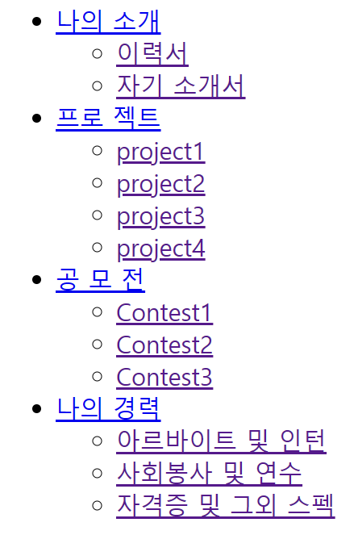
VueJs Frontend
vue_3
전체 메뉴 구성
서브메뉴 => display : none;
메인 메뉴: hover => display: block;
<ul>
<li>
<li>
<li>
<li>
메인 메뉴
메뉴
<ul>
메뉴
<ul>
메뉴
<ul>
메뉴
<ul>
<li>
<li>
<li>
<li>
<li>
<li>
<li>
<li>
<li>
<li>
<li>
<li>
메뉴
메뉴
메뉴
메뉴
메뉴
메뉴
메뉴
ㅍ
메뉴
메뉴
ㅍ
ㅍ
서브 메뉴

Slide 28
<template>
<div id ="index" >
<header>
김창복의 portfolio
<br />
"준비된 개발자"
</header>
<div id="container">
<div id ="nav">
<ul class="menu">
<li> <a href="#">나의 소개</a>
<ul class="submenu">
<li><router-link to="/resume"> 이력서 </router-link></li>
<li><router-link to="/selfintro"> 자기 소개서 </router-link></li>
</ul>
</li>
<li> <a href="#">프로 젝트</a>
<ul class="submenu">
<li><router-link to="/project1"> project1 </router-link></li>
<li><router-link to="/project2"> project2 </router-link></li>
<li><router-link to="/project3"> project3 </router-link></li>
<li><router-link to="/project4"> project4 </router-link></li>
</ul>
</li>
vue_3
App.vue
Main menu
Sub menu
Main menu
CSS가 없을 경우
Sub menu
Menu start
Main menu
Sub menu
Main menu
Sub menu
Main menu
Main menu
Sub menu
Sub menu

Slide 29
VueJs Frontend
vue_3
Main menu
Main menu
<li> <a href="#">공 모 전</a>
<ul class="submenu">
<li><router-link to="/contest1"> Contest1 </router-link></li>
<li><router-link to="/contest2"> Contest2 </router-link></li>
<li><router-link to="/contest3"> Contest3 </router-link></li>
</ul>
</li>
<li> <a href="#">나의 경력</a>
<ul class="submenu">
<li><router-link to="/career1"> 아르바이트 및 인턴 </router-link></li>
<li><router-link to="/career2"> 사회봉사 및 연수 </router-link></li>
<li><router-link to="/career3"> 자격증 및 그외 스펙 </router-link></li>
</ul>
</li>
</ul>
</div>
<br /> <br />
<div id = "main">
<hr />
<router-view />
<hr />
</div>
</div>
Sub menu
Sub menu
Main menu
Sub menu
Main menu
Sub menu
Main menu
Sub menu
Menu end
<footer>
Copyright 2023. 지은이 all rights reserved.
<br />
연락처 : 010-8906-3946
</footer>
</div>
</template>
<style src="./App.css">
</style>
Main menu
Sub menu

Slide 30
VueJs Frontend
vue_3
src/routes/index.js
중복 Routing 필요 없음
Index.js
import { createWebHistory, createRouter } from "vue-router";
import IndexComp from "../components/IndexComp";
import ResumeComp from "../components/ResumeComp";
import SelfIntroComp from "../components/SelfIntroComp";
import ProjectComp1 from "../components/ProjectComp1";
import ProjectComp2 from "../components/ProjectComp2";
import ProjectComp3 from "../components/ProjectComp3";
import ProjectComp4 from "../components/ProjectComp4";
import ContestComp1 from "../components/ContestComp1";
import ContestComp2 from "../components/ContestComp2";
import ContestComp3 from "../components/ContestComp3";
import CareerComp1 from "../components/CareerComp1";
import CareerComp2 from "../components/CareerComp2";
import CareerComp3 from "../components/CareerComp3";

Slide 31
VueJs Frontend
vue_3
src/routes/index.js
Index.js
const routes = [
{
path: "/",
component: IndexComp,
},
{
path: "/resume",
component: ResumeComp,
},
{
path: "/selfintro",
component: SelfIntroComp,
},
{
path: "/project1",
component: ProjectComp1,
},
{
path: "/project2",
component: ProjectComp2,
},
{
path: "/project3",
component: ProjectComp3,
},
{
path: "/project4",
component: ProjectComp4,
},
{
path: "/contest1",
component: ContestComp1,
},
{
path: "/contest2",
component: ContestComp2,
},
{
path: "/contest3",
component: ContestComp3,
},
{
path: "/career1",
component: CareerComp1,
},
{
path: "/career2",
component: CareerComp2,
},
{
path: "/career3",
component: CareerComp3,
},
];
const router = createRouter({
// 라우트 생성
history: createWebHistory(),
routes,
});
export default router;

Slide 32
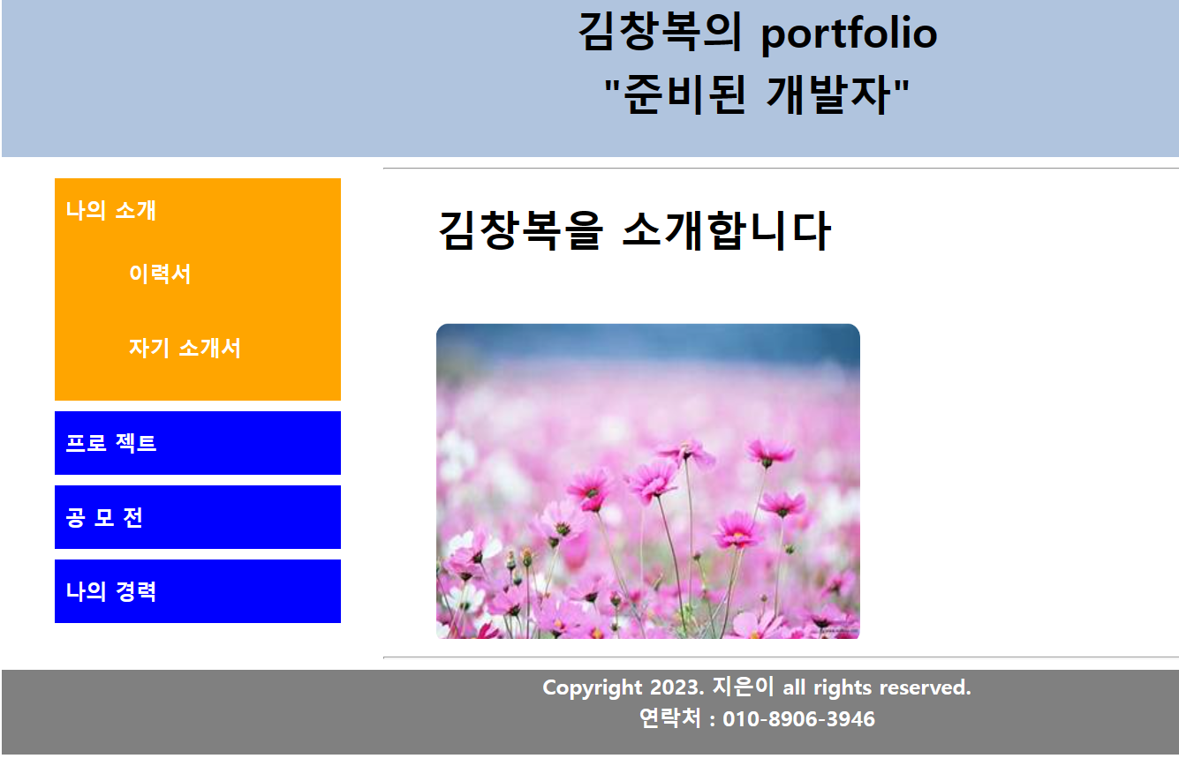
VueJs Frontend
vue_3

Slide 33
VueJs Frontend
vue_3
@import url("https://fonts.googleapis.com/css2?family=Song+Myung&display=swap");
@import url("https://fonts.googleapis.com/css2?family=Nanum+Gothic:wght@700&display=swap");
@import url("https://fonts.googleapis.com/css2?family=Nanum+Pen+Script&display=swap");
#index{
font-family : 'Jeju Gothic';
margin-left:50px ;
margin-right:50px ;
line-height: 1.5;
font-weight: bolder;
}
header {
font-size: 40px;
height: 150px;
text-align: center;
background-color: lightsteelblue;
}
#container {
display: flex;
}
#nav{
flex: 1;
font-size:20px ;
/* text-align: center; */
}
#main{
flex: 4;
font-size: 20px;
margin-left: 20px;
}
li {
list-style: none;
width:250px;
padding:10px;
margin : 10px;
}
a {
text-decoration: none;
color: white;
}
.menu {
width: 300px;
}
.menu > li {
line-height: 40px;
background-color: blue;
}
.submenu {
display: none;
}
.menu > li:hover {
background-color: orange;
transition-duration: 1s;
}
.menu > li:hover .submenu {
display: block;
transition-duration: 1s;
}
.menu 바로 아래 li
안보임 / 영역도 차지 않함
메뉴 위에 마우스 올리면
서브 메뉴가 보임

Slide 34
VueJs Frontend
vue_3
React
Vue
const Career1 = () => {
return (
<div>
<h1>아르바이트 및 인턴</h1>
<fieldset>
<legend>아르바이트</legend>
<ul>
<li>아르바이트에 대한 내용을 작성</li>
<li>아르바이트에 대한 내용을 작성</li>
</ul>
</fieldset>
<fieldset>
<legend>인턴</legend>
<ul>
<li>인턴에 대한 내용을 작성</li>
<li>인턴에 대한 내용을 작성</li>
</ul>
</fieldset>
</div>
);
};
export default Career1;
<template>
<div class="career">
<h1>아르바이트 및 인턴</h1>
<fieldset>
<legend>아르바이트</legend>
<ul>
<li>아르바이트에 대한 내용을 작성</li>
<li>아르바이트에 대한 내용을 작성</li>
</ul>
</fieldset>
<fieldset>
<legend>인턴</legend>
<ul>
<li>인턴에 대한 내용을 작성</li>
<li>인턴에 대한 내용을 작성</li>
</ul>
</fieldset>
</div>
</template>
<style scoped>
</style>

